Slide 1

Understanding Mission, Vision and Career
Notes:
Hello Vertos, welcome you to our fourth lecture which is based on understanding mission, vision and career but before discuss about it let’s have the overview of this topic .

Slide 2
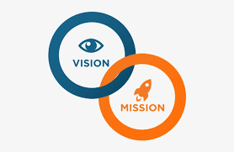
Notes:
A vision is your college's goal—where you hope to see it in the future. The mission provides an overview of the steps planned to achieve that future. A vision is concise and easy to recall, whereas a mission is lengthier and more explanatory in nature.

Slide 3
We will cover topics:-
What is Mission
What is Vision
Connection between Mission and Vision
Importance
How to plan Mission and Vision
Notes:
Before discussing Career we will have a better understanding on Mission and Vision as without that we can not plan out career.

Slide 4

Notes:
A career means you do the same type of work over the years. A career can be one job or many jobs. A career has a goal of improving your skills so you can grow in your job, or move into another job.

Slide 5
We will cover topics:-
What is Career
Relation between Mission, Vision and Career
Importance of Career
Types of Career
Steps to take care of for better future
Notes:
These topics designed keeping in mind that you will get a good overview on understanding mission, vision and career

Slide 6

Notes:
Thank you and see you soon!

